Slide 2
Ecological Validity in Assessment
Ecologically valid assessments are sensitive to
  chronological and developmental ages
  medical status
  physical and sensory abilities
  education
  occupation
  cognitive level
  and cultural, socioeconomic, and linguistic backgrounds

Slide 3
Criteria for Evaluating Ecological Validity
(Franzen & Wilhelm, 1998)
Objectification
  To what extent can the results of the assessment be qualitatively or quantitatively specified?
Generalizability
  Given the assessment results, is one likely to make the same statements (predictions) about real-life behavior?
Sufficiency
  Will the information from the assessment allow us to draw reasonable conclusions about real-life phenomena or require additional information in the form of external variables?

Slide 4
Beyond Aesthetics
Digital photography = Highest degree of realism possible
More representative of how an individual would learn and rehearse vocabulary in the real world
May offer a truer test of the breadth of an individual’s vocabulary knowledge than a test that uses line drawings

Slide 5
Iconicity & Augmentive
Alternative Communication
Fuller and Lloyd (1991) continuum of understanding the connections between symbols and their referents.
  Transparent
  Translucent
  Opaque
Color digital photographs have transparent to translucent iconicity.
Color line drawings have more translucent and sometimes opaque iconicity.

Slide 6

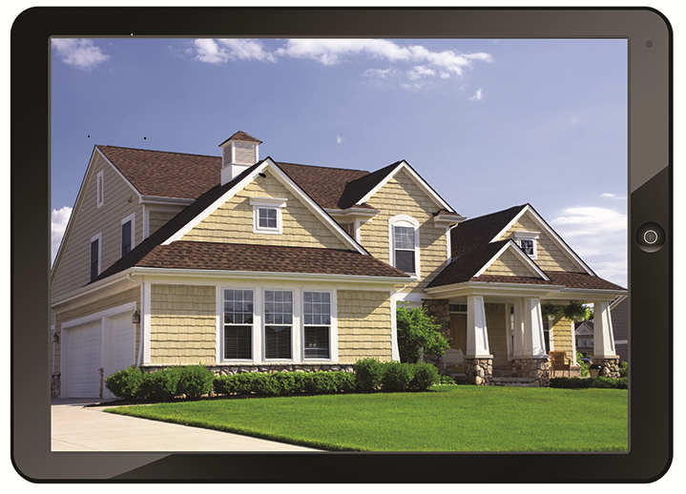
That was then.
This is now.

Slide 7
Digital or paper stimuli
  Digital for use on your tablet or paper for traditional assessment
Greater ecological validity
  Full-color digital photographs provide the highest degree of realism possible
Enhanced skill assessment
  Composite and discrepancy scores enhance ability to assess differences between expressive and receptive skills

Slide 8
Assessment throughout the lifespan
  Suitable for evaluating ages 2.5 to 95 years, offers both age- and grade-based norms
Monitor effectiveness of interventions
  Co-normed with equivalent parallel forms; provides change scores for measuring growth over time and in response to targeted interventions

Slide 9
Normative Sample
Collected Summer of 2010 to Summer of 2012
Post-stratification weighting based on 2009 Census
  N = 2678 individuals from 30 states
28 age groups
  2.5 to 95 years
14 grades
  pre-K to 12th grade
  Split into fall (n = 835) and spring (n = 816)

Slide 10
Correlation between VAS and Other Picture Vocabulary Tests
Scale | VAS-E | VAS-R | Vocabulary Composite
PPVT-4 | .73** | .68** | .75**
EVT-2 | .78** | .66** | .77**
ROWPVT | .83** | .70** | .82**
EOWPVT | .70** | .67** | .73**
Note. N = 50. Correlation shown between standard scores. ** p <.01

